Slide 1
PROJECT - II
Web Scraping From Web
&
Word Frequency
Presentation By
Jovita Tigga
Start Date : January 9, 2023
Submitted On : February 3, 2024

Slide 2
Table Of Content
Definitions
Web Scraping
Word Frequency
Live Demo
Conclusion

Slide 3
Scraping
Using tools to gather data you can see on a webpage A wide range of web scraping techniques and tools exist. These can be as simple as copy/paste and increase in complexity to automation tools, HTML parsing, APIs and programming.
HTTP - HyperText Transfer Protocol Machine interchange information transported over the Internet to enable multi-media data exchange, aka WWW. The protocol defines aspects of authentication, requests, status codes, persistent connections, client/server request/response. etc.
HTML - HyperText Markup Language The standard markup language on the Web As the web evolves so does the proliferation of technical wrappers surrounding the visible content of websites (text and data)
Parsing The act of analyzing the strings and symbols to reveal only the data you need.
Definitions

Slide 4
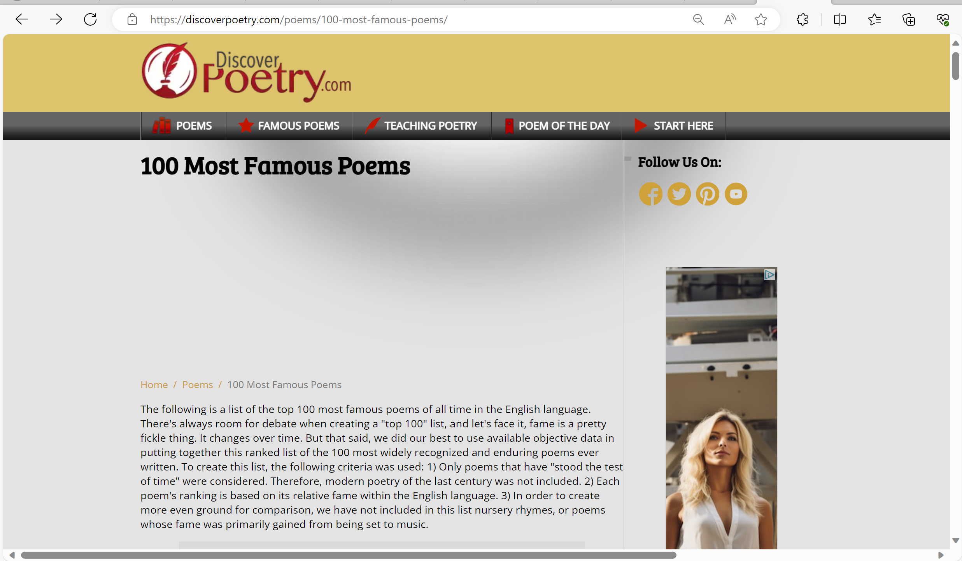
Web Scraping
Web scraping is a software technique of extracting information from website.
It focuses on transformation of unstructured data on the web (typically HTML), into structured data that can be stored and analyzed.
Getting Started !!
Fetched the Data from website : "https://discoverpoetry.com/poems/100-most-famous-poems/"
Send the HTTP request to the server.
Used request library: ‘import requests’ to send a GET
request to the website and store the response object.
Used Beautiful Soup for parsing the response.
And Export the data in the text file.

Slide 5
WORD FREQUENCY
Word frequency is a term that refers to how often a word appears in a text or a corpus. It is often used in natural language processing, text analysis, and computational linguistics to measure the importance, popularity, or relevance of words.
One way to calculate word frequency in Python is to use a dictionary, where the keys are the words and the values are the counts.
To get the word counts and word frequency from text file, I have used the string libraries : ‘import string’ and integer dictionary.

Slide 6
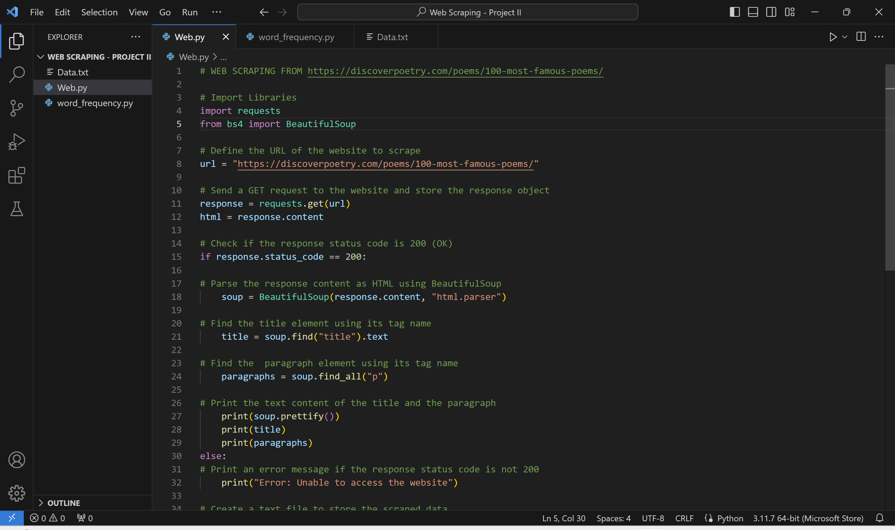
LIVE DEMO

Slide 7
CONCLUSION
“Request Library” is a powerful tool for making HTTP requests and interacting with web APIs.I have covered the basics of sending GET requests.
“Beautiful Soup” is a Python library helped to scrape data from the web pages. It can parse HTML and XML documents and extract information from them. We can find specific elements, attributes, or text in a web page, or to modify the HTML structure of a web page through Beautiful Soup.
A string is a data structure that represents a sequence of characters.
With the help of above libraries I was able to perform the Web Scraping from the website and saved the data in the text file and checked the word count and word frequency.

Slide 8
THANK YOU

